Slide 1

Solving Problems with Both Text and Numerical Data Using Gradient Boosting
Kirillov Stanislav, Head of CatBoost team @ Yandex
Notes:
Hello! My name is XXX and i am YYY at Yandex. Yandex is a big Russian internet company, that has different services, such as Internet search engine, Taxi service, Food delivery, Self driving cars, media streaming and many other.
And today I want to talk about a GBDT library CatBoost – wich is widely used in Yandex and in many other companies. I hope CatBoost can be useful for you.

Slide 2
Tutorial plan
CatBoost overview presentation
Practical part
Notes:
I’ll start my talk with Gradient boosting overview, than we will discuss CatBoost library, then we will study some CatBoost usecases.
After that I will talk about CatBoost superpowers – cuda training speed, distributed training and different feature types support.
In the last part I’ll talk about big data training support.

Slide 3
Tutorial notebook: practical part
Run locally (Cuda GPU expected)
git clone https://github.com/catboost/tutorials.git &&
cd events/2020_odsc_west
Or download by direct link https://bit.ly/34GXw23
Run online in collaboratory
https://colab.research.google.com/github/catboost/catboost/blob/master/events/2020_odsc_west/text_features.ipynb
Shorter url:
https://clck.ru/Rg5qt
Notes:
I’ll start my talk with Gradient boosting overview, than we will discuss CatBoost library, then we will study some CatBoost usecases.
After that I will talk about CatBoost superpowers – cuda training speed, distributed training and different feature types support.
In the last part I’ll talk about big data training support.

Slide 4
Presentation plan
GBDT and CatBoost overview
CatBoost: use cases
Supported feature types: categorical, text and embeddings
Uncertainty estimation
Notes:
I’ll start my talk with Gradient boosting overview, than we will discuss CatBoost library, then we will study some CatBoost usecases.
After that I will talk about CatBoost superpowers – cuda training speed, distributed training and different feature types support.
In the last part I’ll talk about big data training support.

Slide 5


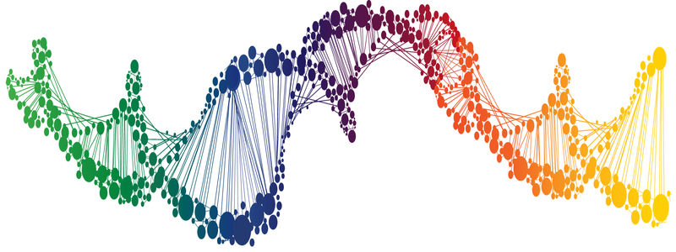

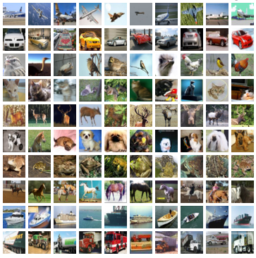
Applied ML (supervised learning)
Applications
Data at hand
Tool
DNA
Text
Linear models
Neural nets
Decision trees
GBDT
etc
Medicine
Finance
+
+
Sales prediction
Images
Music
Notes:
CatBoost is a library that solves supervised learning task
Here on a slide is a rough illustration of what supervised learning consist of of:
we have some application where we want to apply ML techniques
We have some data at hand, that could be used to solve our problem. This data contains samples and each sample have associated label. The task is to predict label based on sample features in some optimal way. Applications defines what the optimal way is. And to predict in this optimal way we optimise some loss function, that directly or indirectly drives training for optimal model
Finally, we have bunch of libraries that could be used to solve the problem
This libraries, usually, generalise well for different applications. Linear models, GBDT, Decision tress — all this could be used for different types of predictions problems: classification, regression, ranking — just select the proper loss function
But, different tools work well with different data
For examples, for images CNN are the best choice
For speech recognition recurrent neural networks provides great results

Slide 6
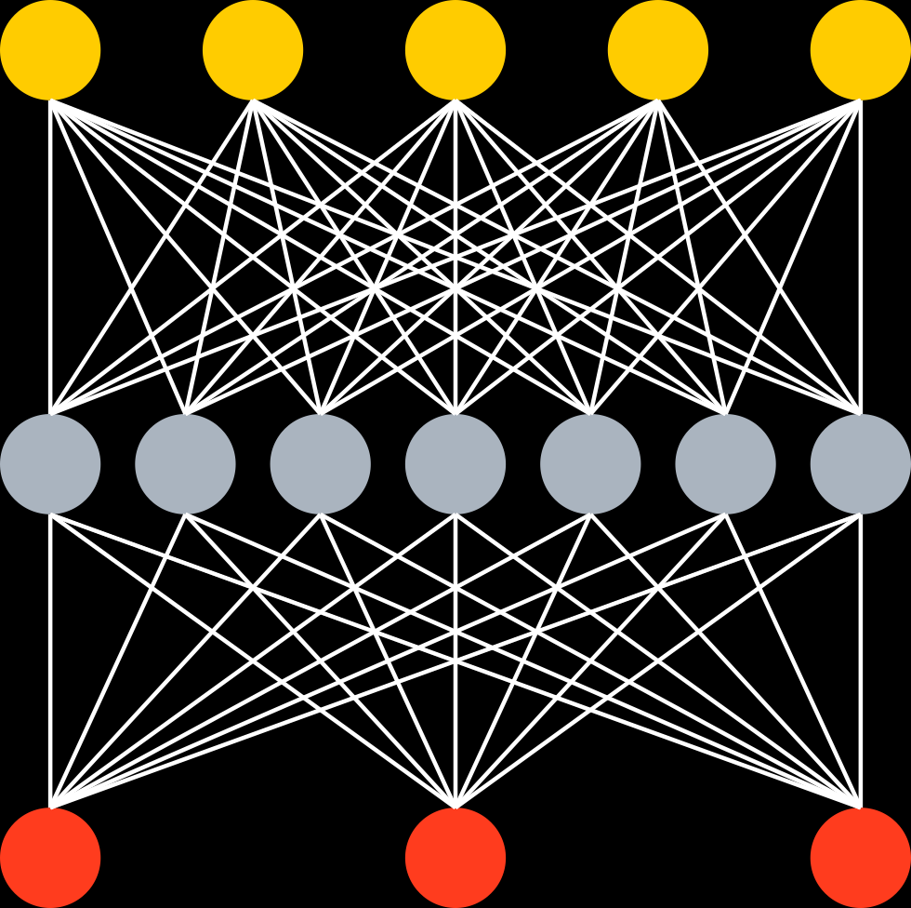
Data at hand
Tabular (or structured) data
Unstructured data
Well engineered features
^{Music track length} | ^{Year} | ^{Rating} | ^{Label}
² | ¹⁹⁹⁰ | ³ | ¹
³ | ¹⁹⁵⁰ | ⁵ | ⁰
¹⁵ | ¹⁹⁷⁰ | ⁴ | ¹
Music
DNA
Images
Text
End2End with Deep NN
GBDT
+
+
+
+
…
Big error
Better
Ship it
Notes:
Here you can seen one way to classify type of data used to solve practical problems today
Firstly, we have so-called unstructured data, like images, where deep learning techniques shows the great result
Secondly, we have tabular, or structured data: well-engineered features are used to describe sample we use to make predictions.Each sample is just a row of float numbers in table. Plus a label that we need to predict.
For this type of data the state-of-the-art results are achieve by GBDT

Slide 7
Tabular data? Decision trees!
Animal?
No
Yes
Not a cat
Have whiskers?
No
Yes
Not a cat
Purrs?
No
Yes
Cat!
Not a cat
Notes:
Let me recall what is Decision Trees and why they are so powerfull still.
Decision Tree is a simple structure with some condition in it’s nodes and some values in it’s leafs. In simple case, model leafs contains final predictions, also there could be more complex leafs with additional formulas in them.
Main disadvantage of Decision trees is that it’s really hard to avoid overfitting, or even full memorization of training dataset. That leads to less then optimal generalization abilities of such models.

Slide 8
Gradient boosted decision trees
State-of-the-art quality on tabular data
Easy to use, no sophisticated parameter tuning
Works well with small data and scales for big data problems
Big error
Notes:
To overcome decision trees flaws a rather simple technique, named gradient boosting could be used.
This is power technique that builds an ensemble, or linear combination, of decision trees. And builds it in a greedy way. Method starts with just one tree, this tree usually have big error

Slide 9
Gradient boosted decision trees
State-of-the-art quality on tabular data
Easy to use, no sophisticated parameter tuning
Works well with small data and scales for big data problems
+
Big error
Better
Notes:
Then we iteratively and a new tree is learned to corrects errors performed by previous ones

Slide 10
Gradient boosted decision trees
State-of-the-art quality on tabular data
Easy to use, no sophisticated parameter tuning
Works well with small data and scales for big data problems
+
+
+
+
…
Big error
Better
Ship it
Notes:
This technique is very easy to use, and it has a really small number of parameters you have to tune manually to achieve good quality of model. For GBDT is’t often enough to use just 3 parameters: maximum depth of tree, number of trees you want to train and learning rate. And thats all, you could spend the rest of time working with the data, not with model parameters tuning.
Gradient boosting works well on small datasets and could be scaled for big ones.
And this method allows you to accurately check and avoid overfitting – you could look at target loss function values change on validation set and stop train when it stops increasing and start to decrease or even cut some trees from your model after training.

Slide 11
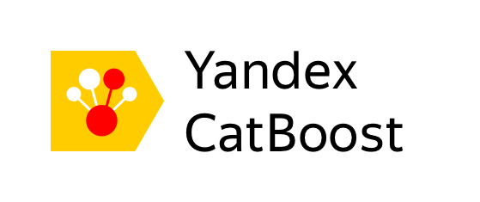


Main Boosting libraries
LightGBM
Notes:
Today we have several highly efficient implementation of this technique: XGBoost, CatBoost and LigthGBM, all of them are different realizations of that powerful idea. And all of them supports training time boost by offloading computations on GPU.

Slide 12
CatBoost overview
Notes:
So now when you've got an idea of gbdt let's overview some catboost features. Of course, we can't go through all of them, so we'll discuss main.

Slide 13
CatBoost advantages
Good quality with default parameters
Good GPU training speed
Sophisticated categorical, text and embedding features support
Model analysis tools
Set of tools to make GBDT usage easier
Notes:
Today we are talking about CatBoost. What distinguishes Catboost from other libraries?
First – we spend a lot of time tuning default parameters of CatBoost to make it work with pretty good quality with default parameters
Second – we are proud of our GPU boosting implementation, that allows you to train bigger models with lot’s of trees faster.
Moreover, CatBoost supports different feature types: not only floating point numbers and numeric|string categorical features. Catboost also supports texts and object embeddings out of the box.
Also catboost has different built-in instruments to analyze and vizualize models: feature strength, shap values, object strength, feature statistics and so on.
And many other functions and tools that help you to work with models and deploy them in production.

Slide 14






CatBoost in the Wild
Recommendations at Netflix
Hotel ranking in Aviasales
Protection against bots in CloudFlare
Particle classification in CERN
Medical research at University of NSW Sydney
Destination prediction in Careem taxi service
ML competitions on Kaggle
Join our Awesome Users List! ☺
Notes:
Let me now show you some usecases of CatBoost outside of yandex
First big example – is Netflix, that uses CatBoost model as a part of it’s recommendation system
Another example – ranking hotel offerings for Aviasales airplane ticket booking users to deliver them most relevant offers.
In CloudFlare CatBoost model is used to detect bot login attempts and protect against them
Also, CatBoost model was a part of CERN LHCb particle classification – it classifies a particle as muon, proton or other type of particle
Also, CatBoost is used in ML contests on Kaggle, And of course, it’s not a full listing ☺

Slide 15
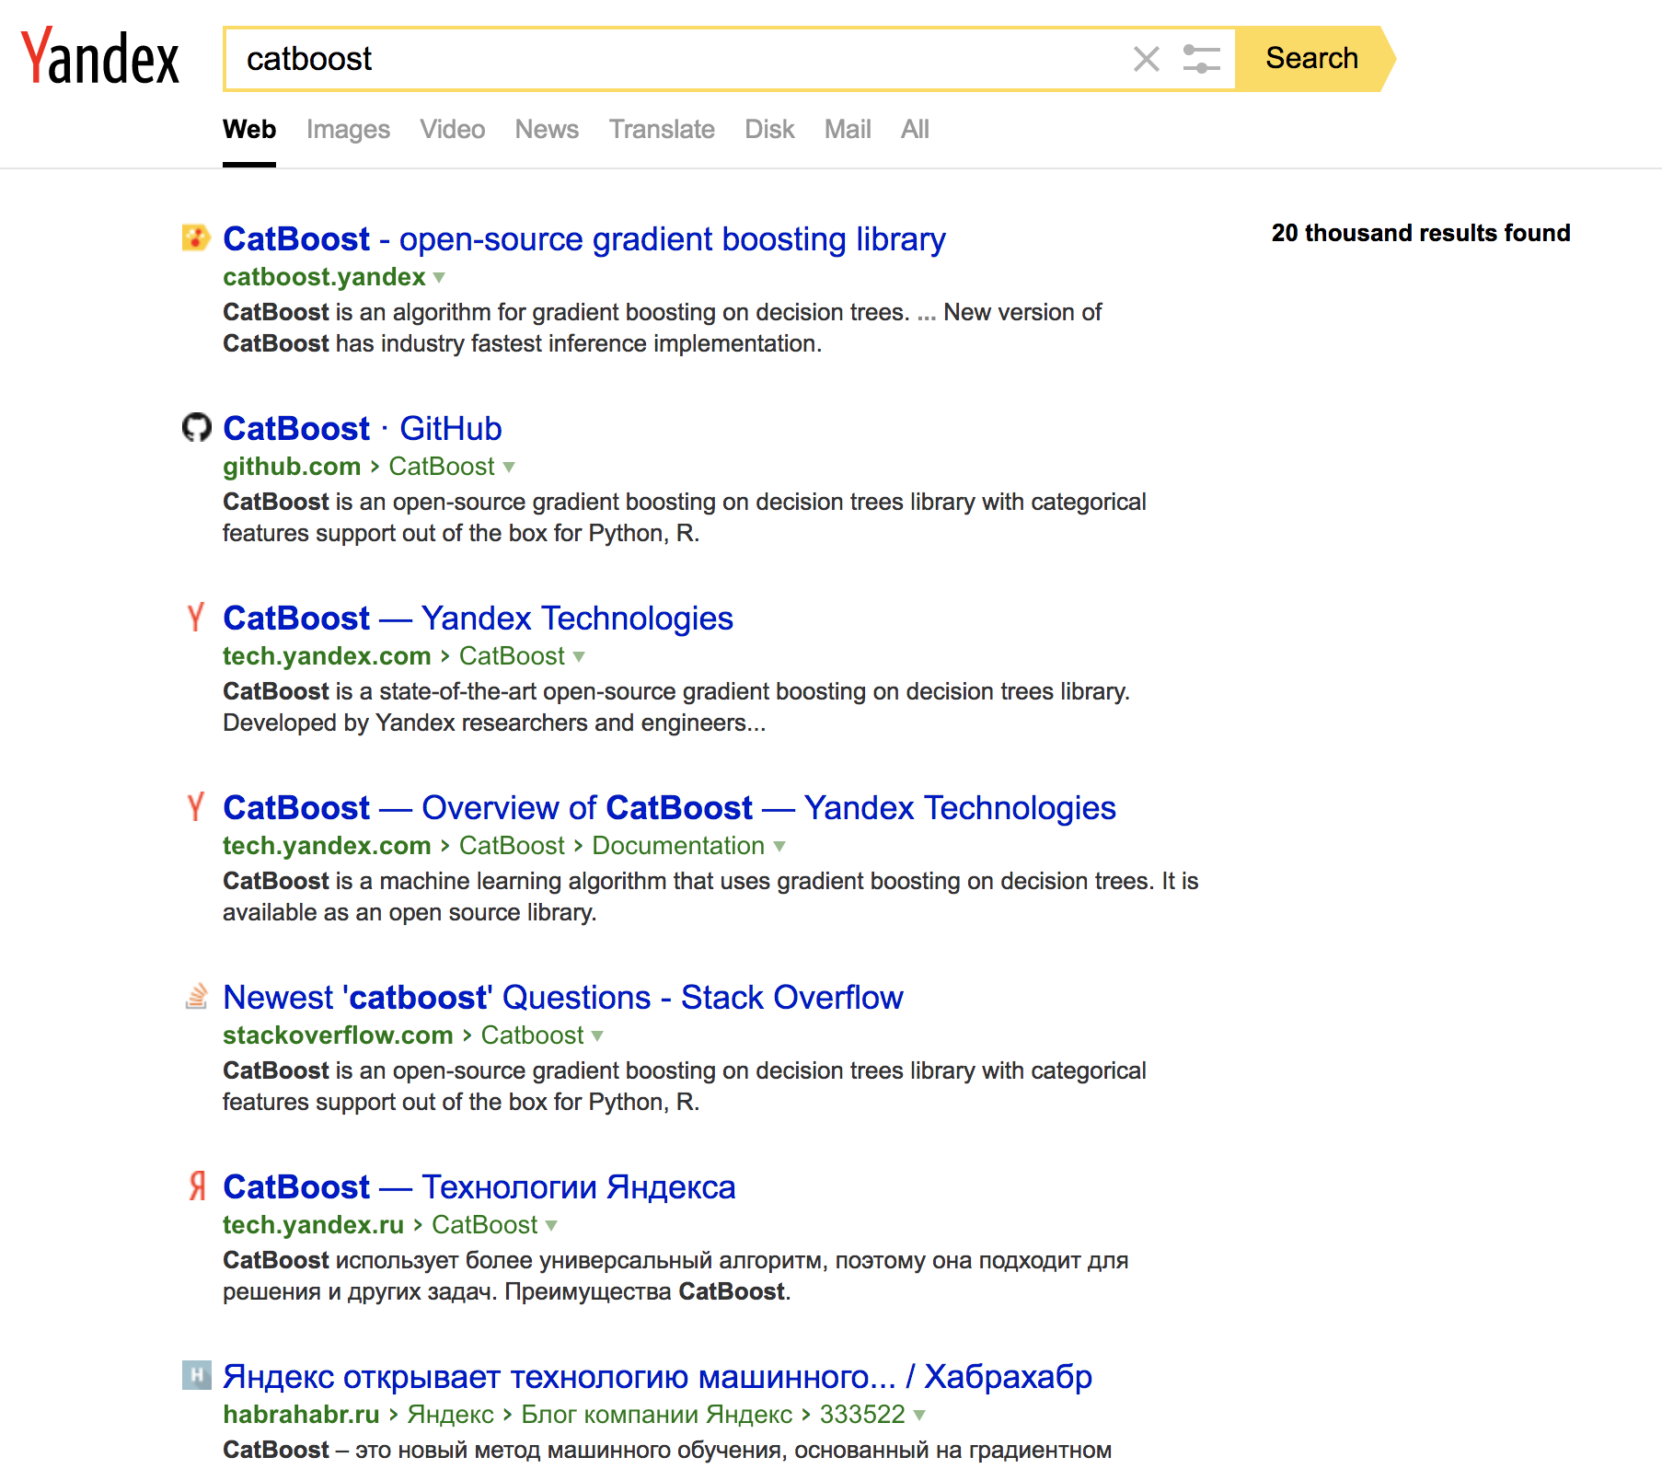
Yandex.Search
Task?
Search document order prediction
Task type: ranking
Dataset features:
Classic features (PageRank, BM25 and others)
Neural Networks output
CatBoost features used:
YetiRankPairwise target
Distributed GPU training
Model blending
Feature importance analysis
Ranking analysis
Notes:
To continue our high-level CatBoost overview, let me describe some interesting use cases of CatBoost in Yandex. The core service of Yandex is Internet Search engine, and to bring to life such a complex technological miracle like search engine you have to use lot’s of different subsystems. All of those systems are data-centric and require to filter and rank document on many levels of search process: starting from web crawler that desides, which sites to crawl, selecting best documents from single data shard, merging results from different sources and finishing with final results ranking.
Top-10 ranking is a classic Ranking task. It’s a hard task, and to train a formula that handle it properly you have to use proper loss function and feed it as much data as you can.
We implemented special loss function for ranking objects – YetiRankPairwise. Ranking functions are not differentiable so we use stochastic gradient estimation that optimizes object ranking order.
Web document is described by thousands of features. We use some classic feature variations, like PageRank, BM25 and others in combination with statistical features on historical data and neural-network features, and it is a classic example of structured heterogenous data and CatBoost works with that data really good.
Thousands of features of hunders million objects leads to really big data sizes –terabytes of raw data. We use combination of distributed multihost multigpu training in combination with data quantization, both techniques allow our analytics and data scientists to train on such data in a matter of hours.
Another powerful technique – model blending. In practice our ranking formula is a patchwork of formulas, trained on different data from sources of different kind with different losses. CatBoost allows to blend lot’s of models in one resulting model that can be easily deployed to production.

Slide 16
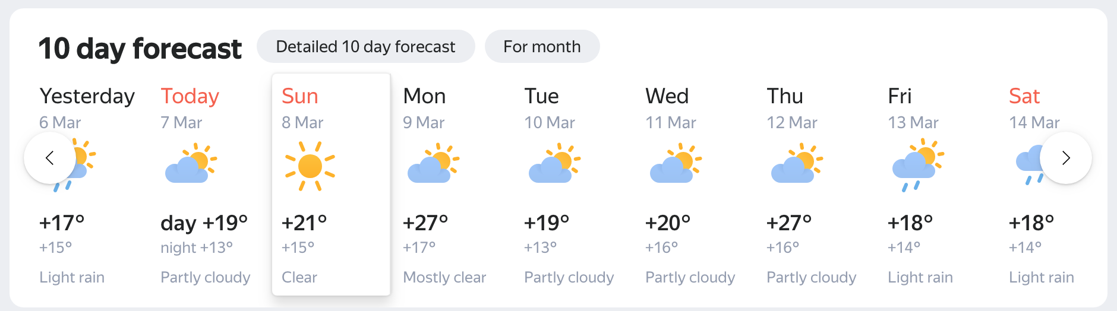
Yandex.Weather
Task?
Cloudiness type and temperature prediction
Task type: multiclassification and regression
Dataset features
Physical weather model output
Neural network output
Online-data from weather stations
Weather historical data
CatBoost features used:
Multiclassification target and RMSE (for temperature)
GPU training
Feature importance analysis
Training process visualization
Notes:
Another interesting task that is solved with help of catboost is weather prediction. It is not a single task, but a set of different subtasks: a regression model for temperature prediction, multiclassification for cloudiness type prediction and lot’s of other models.
Temperature prediction task is another example of heterogenous data input for model – we have different physical weather model predictions, we have online data from weather stations, historical data and even neural network output.
CatBoost allows to blend those data in single prediction.
Another interesting subtask is prediction of cloudiness type: it’s a classical multiclassification task, where outputs of neural networks leads main role – we have different models, one uses meteoradar data, other uses satellite images. Output from both models are used as features for CatBoost model, that blends them in one prediction.

Slide 17
V100 Training performance: 1000 trees
GPU training time on single NVIDIA Tesla V100
Higgs
10.5mln objects
28 features
Epsilon
400k objects
2k features
Airlines
23mln objects
13 features
CatBoost v0.24.1, Lightgbm 2.3.1, XGBoost 1.0.2
Notes:
As i've already said, Yandex is a data-centric company, and to work with such amounts of data at possibly low cost in terms of time and resource, we need to use fastest algorithms. We spent a lot of time to optimize CatBoost GPU training speed and to make it best in class solution for big data tasks.
On this slide you can see comparison of CatBoost GPU speed on 3 different datasets: Higgs, epsilon and Airlines. On two of them catboost runs faster then LightGBM and XGBoost, on Airlines XGBoost wins, but we are currently working on that case :)

Slide 18

Distributed training: multi-host multi-GPU
OpenMPI
Host rank 0
Host rank N
CatBoost
CatBoost
GPU 0
Data 0
GPU 1
Data 1
GPU 4
Data 4
GPU 5
Data 5
…
GPU 0
Data N*8 + 0
GPU 1
Data N*8 + 1
GPU 4
Data N*8 + 4
GPU 5
Data N*8 + 5
GPU 2
Data 2
GPU 3
Data 3
GPU 6
Data 6
GPU 7
Data 7
GPU 2
Data N*8 + 2
GPU 3
Data N*8 + 3
GPU 6
Data N*8 + 6
GPU 7
Data N*8 + 7

Slide 19
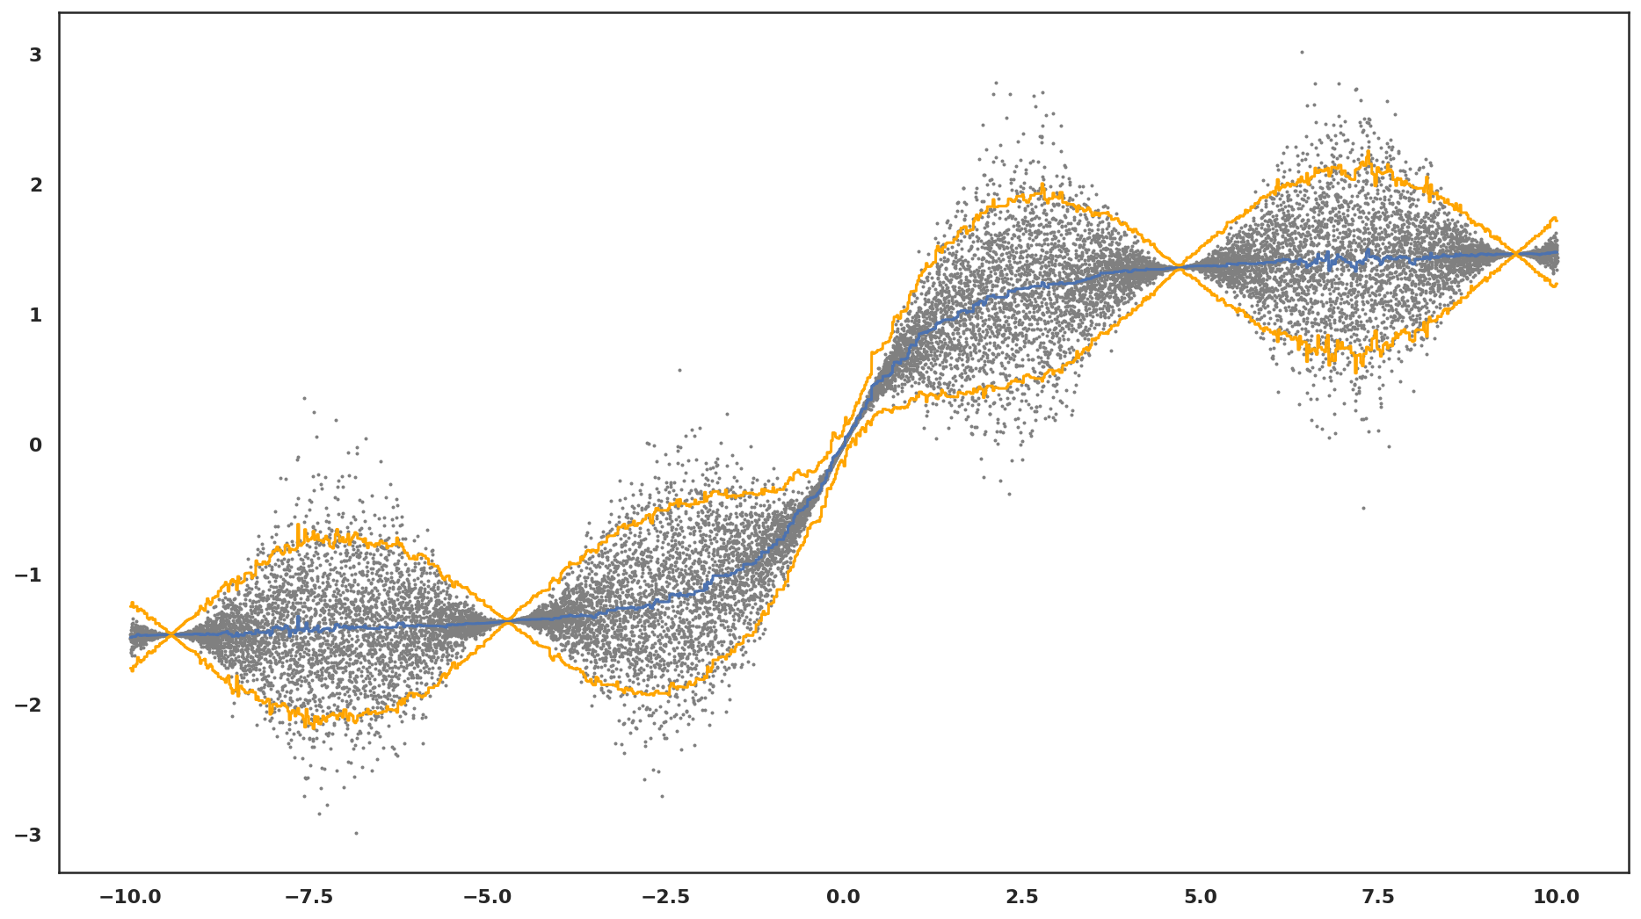
Data and knowledge uncertainty
Notes:
Also this scheme has one major limitation – currently, all the data Is read and distributed to other hosts via process on host with zero rank
A command that start training is rather simple, but don’t forget to disable process binding to cpu slot or thread, as it could affect training speed

Slide 20
Categorical features, texts and embeddings
Notes:
Now I’m going to the most interesting part of todays talk – new feature types, supported by CatBoost library. And to start talking about text and embeddings, let me explain how wellknown feature types, such as float and categorical features work in CatBoost.

Slide 21
Numerical features
Yes
Salary > 30 000
No
Notes:
Practically every one had an experience with numerical features – they are every where and are widely used to describe properties of objects. For example, it could be age, height, Base property of Numerical features is that they have some inner order – you can compare feature value for two objects and known, who has smaller or bigger value. And when GBDT model makes a split on such feature, it searches for border value that divides objects by that feature in the way that gives maximum score increase.

Slide 22
Categorical features
Engineer
Categorical data
Designer
Occupation
Writer
Manager
HR
Notes:
Categorical features are features that don’t have any predefined order, by they have another property – value of categorical feature have some set of values and for each given object categorical feature can take only one value from this set. To work as a feature for gradient boosted tree models categorical features should be somehow encoded as numerical value to allow gradient boosting algorithm build binary splits on encoded values. There is no one universal way of preprocessing categorical feature values.

Slide 23

Categorical features handling
Genre
One-hot encoding
Jazz
Rock
Blues
Statistics based on category
Muse
AC/DC
Tool
Category-based
Label based:
calculated “online”
Greedy search for combinations
Artist
Notes:
For example, you can use one-hot-encodings to transform categorical feature to number of sparse numeric features . This is simple and efficient technique, but it works only if categorical feature cardinality is low. In reality, many categorical features has a huge number of different values. As a result, it’s hard to build an ensemble of decision trees with help of this technique.
So, to work with such features one usually makes some feature engineering instead of one hot encoding. And feature engineering is based on problem domain knowledge.
CatBoost combines those to approaches with no additional preprocessing needed. If cat. feature has small number of unique values, CatBoost uses one hot encoding, in other case CatBoost calculate different kind of statistics for categorical feature values. Some statistics are category based: calculate category-value frequency and use it as feature. Another statistics are label-based: they use label statistics for given category. Another powerful technique that is implemented in CatBoost is Greed feature combination candidates selection – on each tree level CatBoost tries to combine available categorical feature values with feature splits that were selected for current tree.

Slide 24
Online features for categories
For every sample “online” feature is calculated using objects with the same category before this one
SDE
1
SDE
1
SDE
0
PR
i
SDE
1
PR
1 + 1 + 0
i
3
Notes:
When you are calculating cat feature statistics it’s critically important to avoid target leakage – it would lead to overfitting on training data. In CatBoost we use technique named online feature estimation – we determine 3 different random orders of objects and then we are using statistics for objects that were before current object in a permutation as a value on current object. We update category statistics with the target value of current object and got to next object

Slide 25

Text features
BM25
at first i was afraid i was petrified kept thinkin i could never live without you by my side
[0, 1, 2, 3, 4, 2, 3, 5, 6, 7, 2, 8, 9, 10, 11, 12, 13, 14, 15]
Naïve Bayes
Bag-of-Words
…
Dictionary
Notes:
When CatBoost have built all the needed dictionaries sequence tokens are converted to sequence of token ids, which is shown on current slide.
Sequences of token ids are then processed with 3 different feature estimators.
The trivial one is Bag of word feature estimator that just creates a binary vector representation of presence of given token id in some object.
Naïve Bayes is a feature estimator that tries to estimate probability of belonging to a class.
Another Feature estimator is a classic BM25, or TFIDF. We use a corpus of all tokens statistics for each class to calculate this metric.

Slide 26
Bag of Words
Default: word unigrams + word bigrams
For a given dictionary (set of tokens)– is this token present in text?
Dictionary 1:
yesterday, petrified
Dictionary 2:
at+first, i+has, could+never, …
at first i was afraid i was petrified kept thinkin i could never live without you by my side
Feature values:
0,1,1,0,1
Notes:
Now let me show examples of those estimators. The simplies text feature estimator is Bag of words. On this slide you can see an example of applying two different dictionaries – first is a single word dictionary, the other one is bigram dictionary. After applying them to text and setting vector values with indices of tokens that were in text to 1 we have bag of words representation of text.

Slide 27
Naïve Bayes
For every class a new feature P(Class|Text)
P(Class|Text) is replaced with P(Class) * Пi P(wordi | Class)
Most importantly: calculate it “online”
Notes:
Naïve Bayes generates a new feature column for each class label.
The value of estimated feature for some class is a product of class probability and product of conditional probability for each token met in current text
When calculating this kind of feature estimator it’s critical to avoid target leakage, so we apply our online technique here.

Slide 28
BM-25 for MultiClass
A new numerical feature for every class of multi-classification
TF – frequency of a word in text
IDF – inverted frequency of a word in a “document”, where
“document” is a concatenation of all texts in this class
Most importantly: calculate it “online”
Notes:
Another important feature estimator is BM25. Again, BM25 generates a new feature column for each class label.
The value of estimated feature for some class is a sum of product of inverted document frequency for token in virtual document that is a concatenation of concatenation of all texts in this class and term frequency in current text
Like in Naïve bayes, it’s critical to avoid target leakage, so we apply our online technique also in that estimator.

Slide 29
Object embeddings
🐶
{x₁, x₂, x₃,…., x_{N}}
For example well known text embeddings: Word2Vec, DSSM, BERT, GPT and another language models.
Notes:
now let's look at a more complicated case when the object has some linked unstructured data – like image, video, or text. To work with this data you can build a vector representation of this data, called object embedding and pass it to CatBoost. Embedding could be a prediction of some model, for example some neural network. For example, there are some well known models that allow you to compute embeddings for texts – it is classical word2vec models , bert and gpt models.
Someone can try feeding those vectors to gradient boosting algorithm as is, and it could somehow work, but training on 736 dimensional vectors that may have rather strange distribution in ndimensional space is a hard task for gbdt.
As our experiments and practical experience summary says, it’s better to somehow reduce dimensionality of embedding vectors to help GBDT make proper splits.

Slide 30
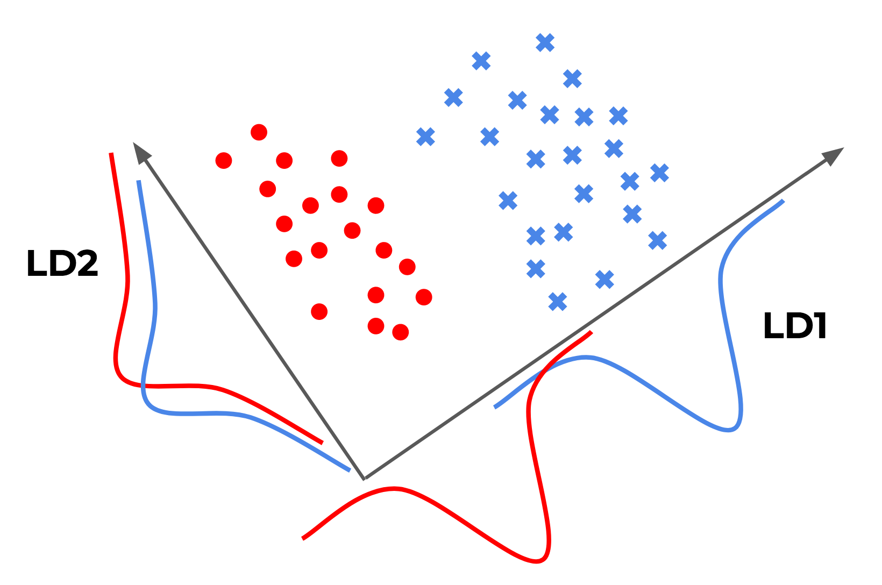
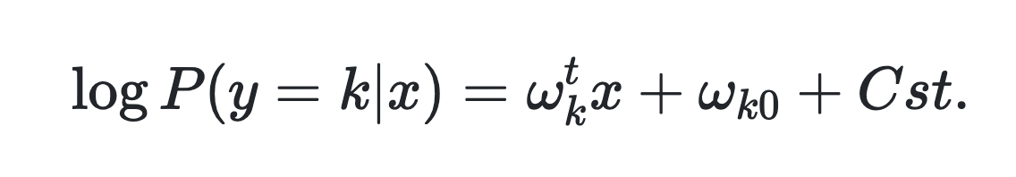
Linear discriminant analysis
https://raw.githubusercontent.com/eigenfoo/eigenfoo.xyz/master/assets/images/lda-pic.png
Notes:
One classical method of dimensionality reduction is making some projections to lower-dimensional subspace. We were trying different kinds of projections and, surprisingly, one of the simplest classical methods worked really good.
I am speaking about linear discriminant analysis.
It is an algorithm that tries to find a linear projections that maximally separate objects of different classes. On this slide there is a simple illustration of two different one dimensional projections - first one, LD1 is a good projection as it properly separates blue crosses from red dots. And LD2 projection provides poor objects separation
And, of course, even that estimator is trained in online setting.

Slide 31
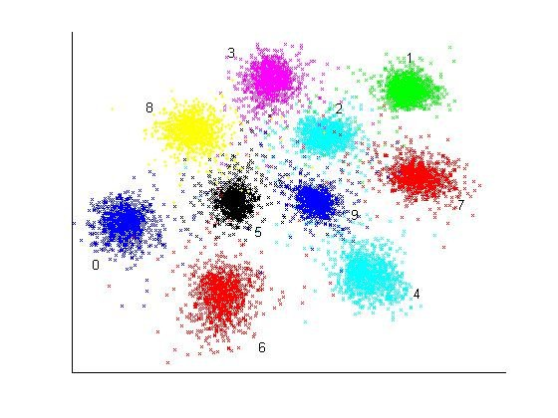
kNN
Online feature estimation.
For each object in permutation:
Query k-nearest neighbours
Get classes for found neighbours
Treat class-frequencies as features for CatBoost
Update HNSW index
A Deep Non-Linear Feature Mapping for Large-Margin kNN Classification - Scientific Figure on ResearchGate.
Available from: https://www.researchgate.net/figure/Two-dimensional-embedding-of-10-000-MNIST-test-data-using-the-Deep-Neural-Network-kNN_fig9_22076648
Notes:
Another emeddings feature estimator that gives quality boost on top of linear discriminant analysis – k nearest neighbors search. For each object we can query k closest training examples in the embedding vectors space.
The proportion of classes in set of k objects neighbors is a ready to use feature for gbdt
We use our own implementation of Hierarchical Navigable Small World and, of course, we are building that index iteratively in online manner to avoid target leakage.

Slide 32
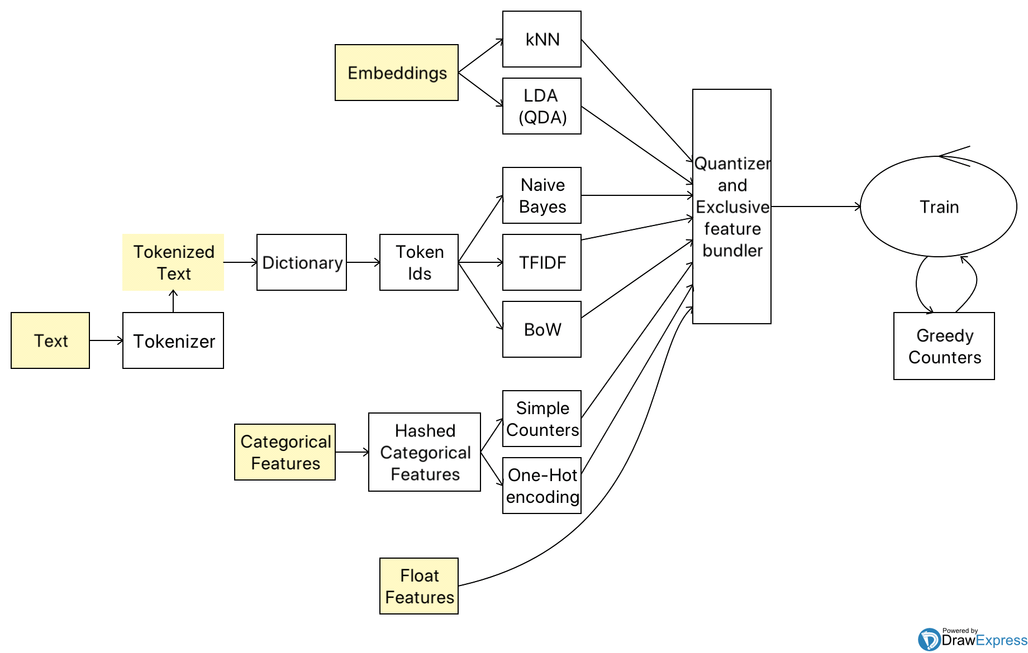
Features in CatBoost
Notes:
Categorical features give our team an idea to extend list of types, that CatBoost supports for training without preprocessing. Now CatBoost has built-in customizable pipeline for training on texts. This pipeline has 4 main stages.
Automatic Tokenization of text. You can select what type of tokenization to use – simple tokenizer will split text into tokens by space, smart could extract punctuation marks and numbers and delete them or replace them with special tokens.
On the next step CatBoost build dictionaries – it could be a character level dictionary with ngramms, or it could be single word dictionary as well as dictionary of word ngrams
Also CatBoost library has separate Python classes for tokenizer and dictionary, but it’s not a topic of our current talk.

Slide 33
Profit from text features and embeddings
Accuracy on IMDB dataset with default parameters
BOW + Online Text Features
0.897
+ Embeddings
0.908
Notes:
We measured quality of training catboost on classical IMDB dataset with and without embeddings – left depicts a result of training catboost on imdb texts only and as you see, CatBoost gives rather good quality even without parameter tuning
And adding bert embeddings help to get another 1 percent point of accuracy also without any tuning.

Slide 34
Questions?
catboost.ai
github.com/catboost
twitter.com/CatBoostML
t.me/catboost_en, t.me/catboost_ru
ods.ai => slack => tool_catboost chanel
Kirillov Stanislav
Head of ML systems group & CatBoost team
Notes:
Thank you for attention! Feel free to ask our team about anything in our official telegram chat and report any bugs and invonviniences to github issues.
Good luck to you and your beloved ones! Stay safe and healthy.

